Slide 1
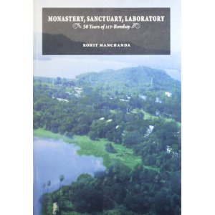
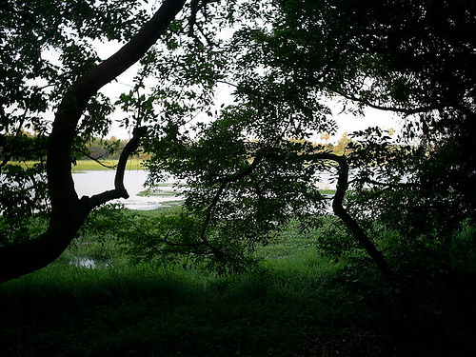
HS 200: Environmental Studies
Socio-cultural and Political Issues
D.Parthasarathy
Humanities and Social Sciences
Economic Perspectives on Environmental issues: Prof.K. Narayanan
Philosophical Perspectives on Environmental issues: Prof.P.R.Bhat

Slide 2
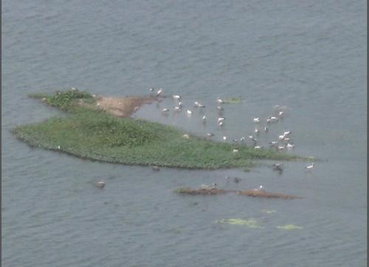
What is nature?
How do we think of nature? How can we think of human-nature relationships? In what ways have human beings changed, evolved, and adapted because of the need to cope with nature?
Is nature socially constructed? Are nature and society separate entities? How do we define, categorize, classify, or understand natural objects?
Nature: Physical or cultural?
Social, cultural, economic, or political context of our understanding or perception

Slide 3
Evolution of human attitudes to Nature:
Sacred
Wild and disordered, uncivilized, should be controlled and dominated, tamed, cultivated, civilized
Humans as part of nature, live with nature; nature for or beyond humans?
Utilitarian or instrumental vs non-utilitarian or intrinsic views
Changing ideas and perceptions of nature and the environment
Thinking sociologically about nature and the environment
How have understandings of ‘nature’ and the ‘environment’ changed over time?
What social transformations have led to these shifts in perception?
How can the social sciences and humanities help us to better understand environmental issues? Beyond economics

Slide 4
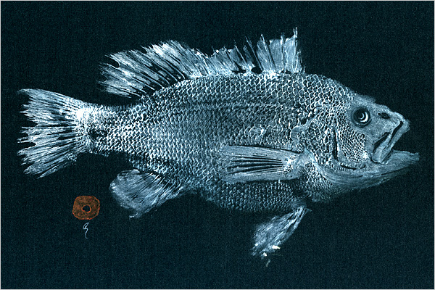
Social construction of FISH
● foods ● pets ● commodities ● ornaments ● resources ● creatures
Fishing:
● Livelihood, ● commercial / industrial activity, ● recreation
Ecological significance

Slide 5
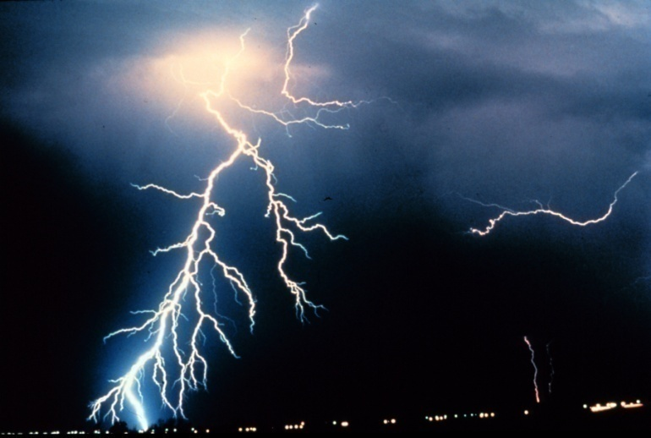
Lightning: (From Wikipedia) Lightning is a massive electrostatic discharge caused by unbalanced electric charge in the atmosphere, either inside clouds, cloud to cloud or cloud to ground, accompanied by the loud sound of thunder.
Religious / spiritual
Source of electricity / energy
Weather phenomemon

Slide 6
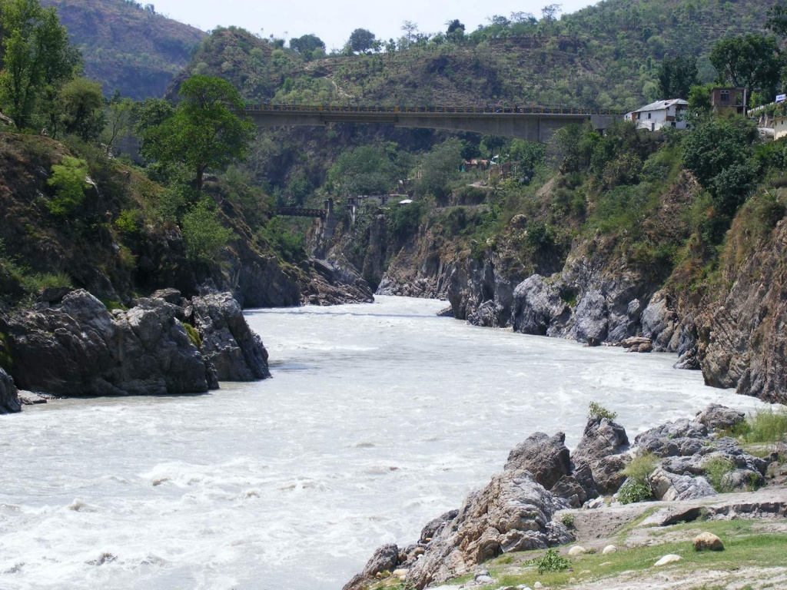

Slide 7
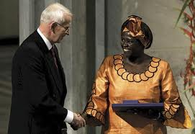
Environment Quiz
Wangari Maathai
2004: First African woman to receive the Nobel Peace Prize for "her contribution to sustainable development, democracy and peace."

Slide 8
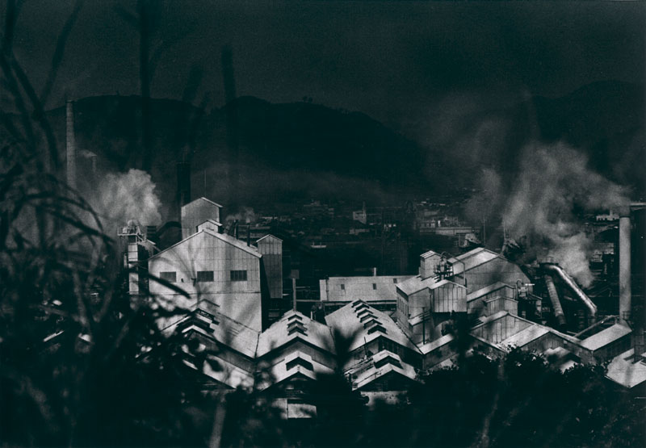
Minamata
Large scale effects of industrial pollution: mercury poisoning

Slide 9
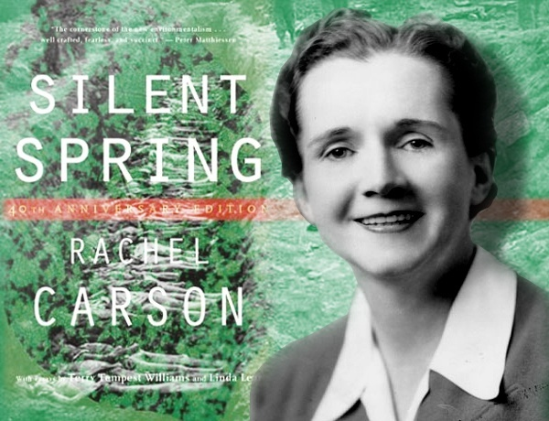
Rachel Carson – Silent Spring
Environmental and health consequences of chemical intensive agriculture
Endosulfan

Slide 10
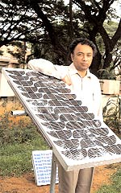
Harish Hande
2011: awarded Ramon Magsaysay award for “his pragmatic efforts to put solar power technology in the hands of the poor, through his social enterprise SELCO India”

Slide 11
So why are nature and the environment sociological issues?
Our perceptions of nature are shaped by society and culture (meanings and beliefs).
Our responses to environmental problems depend upon social
structures and relationships (power and institutions).
Human societies are ultimately dependent upon natural life-support systems (the global eco-system or ‘bio-sphere’).
Our social organisation is shaped by our material interventions into nature (labour and technology).

Slide 12

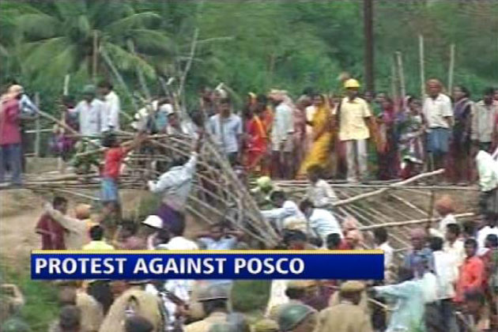
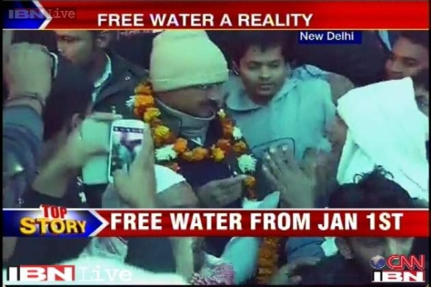
Not Conservation or Protection but social conflicts around natural resources as the central environmental problem
Who owns resources?
Who should own them?
Who should manage resources?
What technologies should be used?

Slide 13
Socio-Ecological interpretations of political, economic and environmental changes
1. Oriental despotism: Karl Wittfogel:
Flood control and water supply for irrigation - basis of Asian hydraulic civilizations and of a powerful, exploitative bureaucracy
Wherever irrigation required substantial and centralized control, government representatives monopolized political power and dominated the economy, resulting in absolutist managerial state
Close identification of officials with the dominant religion and an atrophy of other centres of power. Forced labour for irrigation projects directed by bureaucratic network.
Hydraulic civilizations - ancient Egypt, Mesopotamia, India, China and pre-Columbian Mexico and Peru

Slide 14
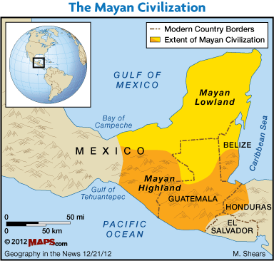
2. Decline of the Mayan Civilization:
Major factor - environmental degradation by people: deforestation, soil erosion and water management problems, resulted in less food
Problems exacerbated by droughts, been partly caused by humans through deforestation.
Chronic warfare made matters worse, as more and more people fought over less and less land and resources
Jared Diamond - author of Guns, Germs and Steel and Collapse: How Societies Choose or Fail to Succeed
http://www.ufppc.org/content/view/1996/2/

Slide 15
3. How Japan survived environmental degradation (Jared Diamond contd.)
Crisis of deforestation, caused by peace and prosperity afterTokugawa shoguns' military triumph that ended 150 years of civil war in 17th C
Japan's population & economic explosion economy - rampant logging for construction of palaces and cities, and for fuel and fertilizer
Shoguns’ response: negative and positive measures
Reduced wood consumption: turn to light-timbered construction
fuel-efficient stoves and heaters
coal as a source of energy
Increased wood production by developing and carefully managing plantation forests
Both shoguns and the Japanese farmerstook a long-term view
Today: highest human population density of any large developed country -yet Japan is more than 70 percent forested

Slide 16
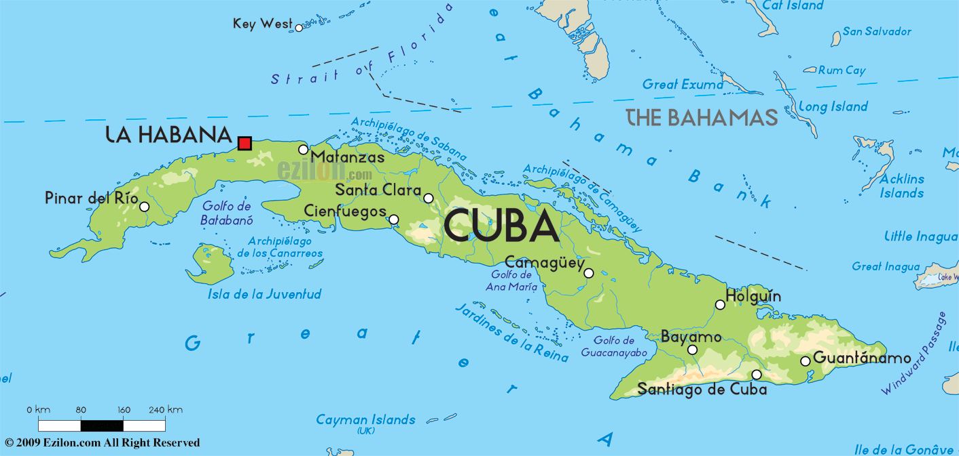
4. The Case of Cuba: Organic Agriculture
Early 1990s - collapse of socialist bloc and the U.S. embargo - decrease in agricultural inputs and foodstuffs
Cuban response to crisis: redesign their system of food production and distribution
Cuba: attempting world's most ambitious and extensive transition from conventional agriculture to organic farming
Cuba: first country to address food production under the premise that sustainable access to safe, nutritious food is a human right
Self sufficient in food using organic methods, surplus generated in cities

Slide 17

Questions about natural resource use, management, ownership, and costs
Why are there struggles / conflicts around natural resources? Why are we not able to share resources equitably?
To whom should resources belong? Private, public, common?
How should resources be governed or managed? Rules and Regulations, customs and traditions

Slide 18
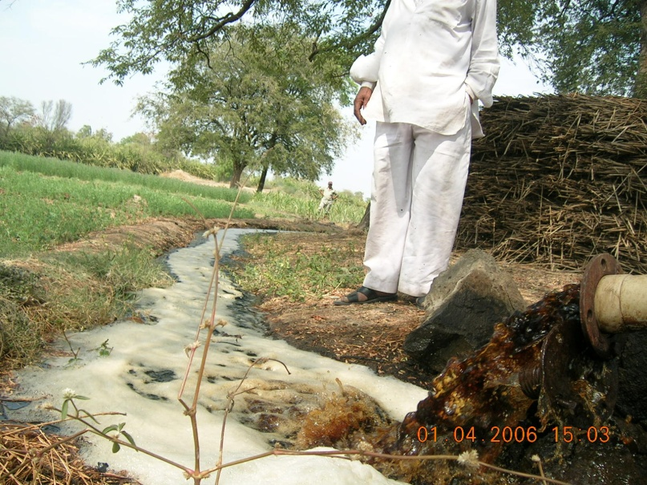
Questions about natural resource use, management, ownership, and costs (contd)
Why does resource degradation occur?
Should resources be shared equitably, or be owned / used only by those who can afford to pay?
Which form of ownership or control is better for preventing resource depletion?
Should we pay for resources? How much should we pay?

Slide 19
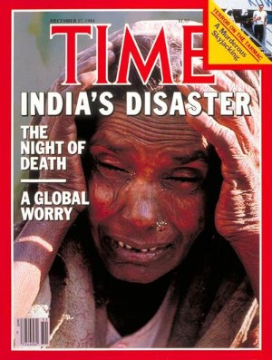
Understanding Environment-Society Interactions and their consequences
Chipko
Silent Valley
Water conflicts
Plachimada
Dams and mutli-purpose projects
Bhopal
Green revolution

Slide 20
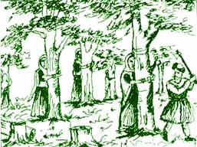
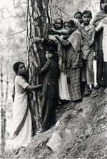
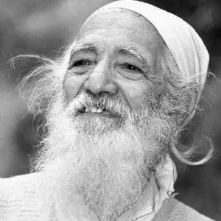
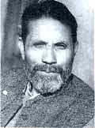
Chipko Movement

Slide 21
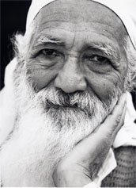
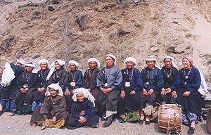
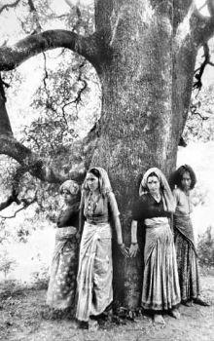
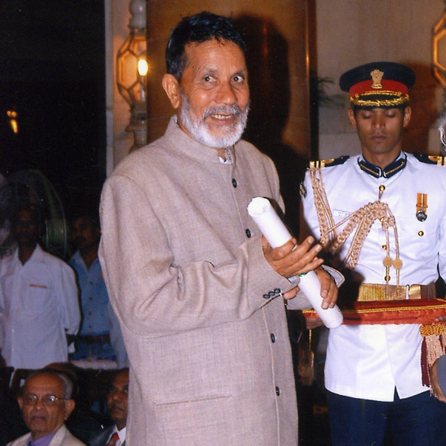
Chipko: Government, Paper Mills / Loggers, People
Sunderlal Bahuguna
Chandi Prasad Bhatt

Slide 22
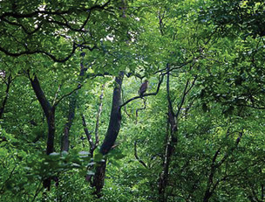
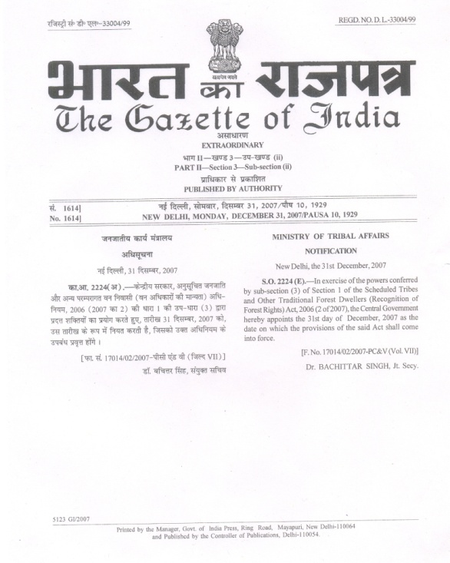
Forest Rights Act: Government, Forest based communities
Experiments in Resource Governance to promote equitable access and environmental sustainability
Forest Rights Act: Gajab Kahani - Struggle for Forest Rights: http://www.youtube.com/watch?v=EES2KtIdI3k
Natural Resource Management in Rural India: How Anna Hazare greened Ralegan: http://www.youtube.com/watch?v=aBfjsdICGT0

Slide 23
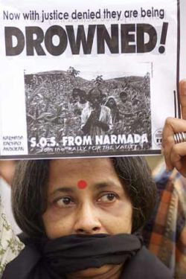
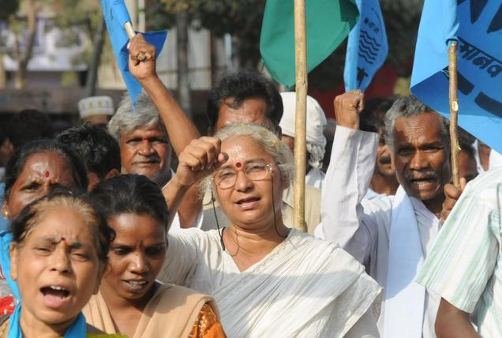
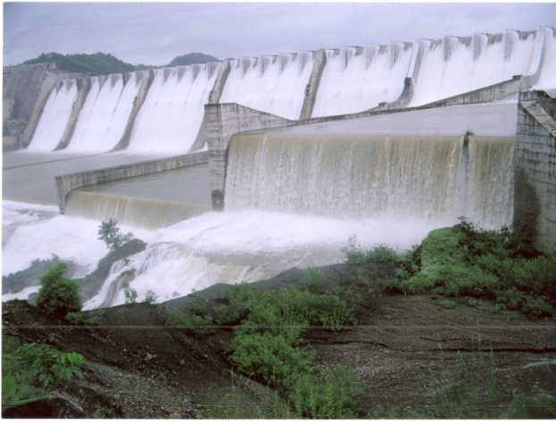
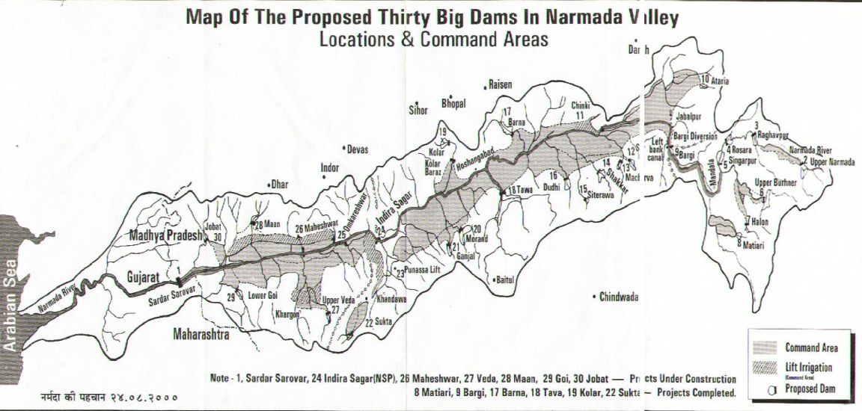
Sardar Sarovar Project (Narmada): Irrigation, Drinking Water, Hydro-electric power, Flood control

Slide 24
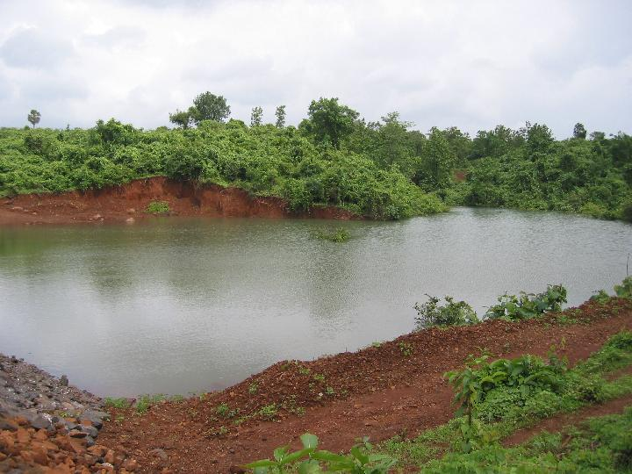
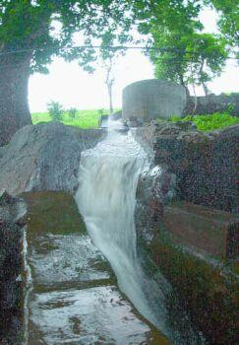
Small scale water solutions?
Belachiwadi Check Dam
Gudwan Check Dam
http://www.cse.iitb.ac.in/~ctara/dam/
Bilgaon

Slide 25
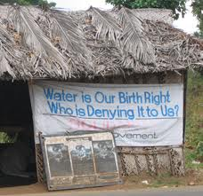
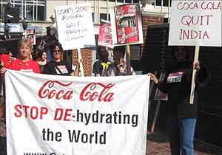
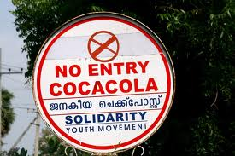
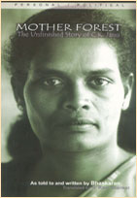
Plachimada: Private ownership vs public access to water (Coca Cola)
To whom does ground water belong?
Adivasi Samkrashana Sangham (Adivasi Protection Front)

Slide 26
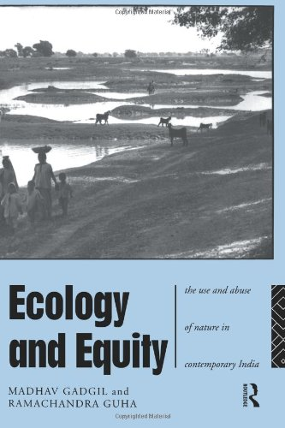
Class and the use and abuse of natural resources (Guha and Gadgil)
Omnivores: industrialists, rich farmers, urban middle classes
Ecosystem people: Rural, those who rely on natural resources (small and marginal farmers, landless labour, pastoralists)
Ecological refugees: Displaced, evicted, resettled, migrants

Slide 27
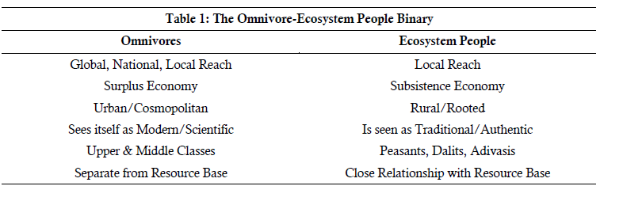

Slide 28
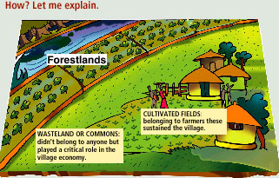
Environment, Governance, and the state
How do humans interact with ecosystems to maintain long-term sustainable resource yields?
What form of ownership and governance is best for sustainability? For preventing resource degradation or depletion?
Regulation
Ownership

Slide 29
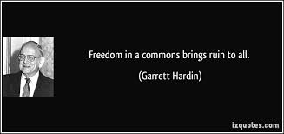
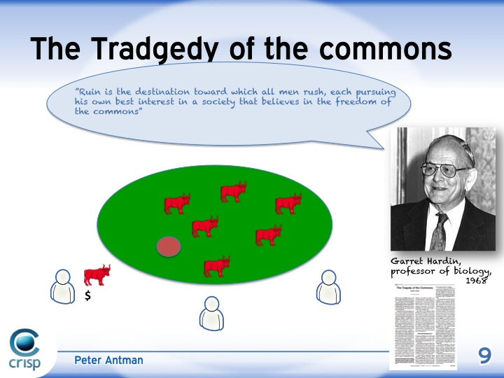

Government, private, or common for efficient resource management?
Common Pool Resources: Water, irrigation systems, Pasture / grazing land, forests, fisheries, oil fields, minerals
Garett Hardin: Tragedy of the Commons?
Free rider – overuse and exploitation?

Slide 30
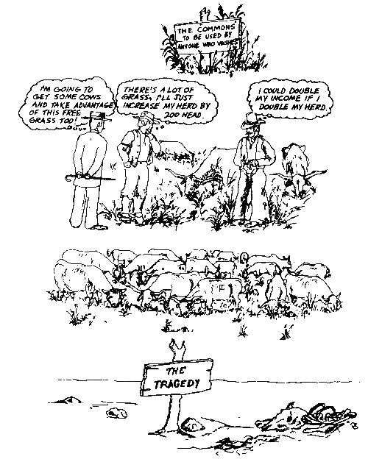
COMMONS: Tragedy or Mutual Benefit?
Understanding the commons: http://www.youtube.com/watch?v=otmrkhEFSZM

Slide 31
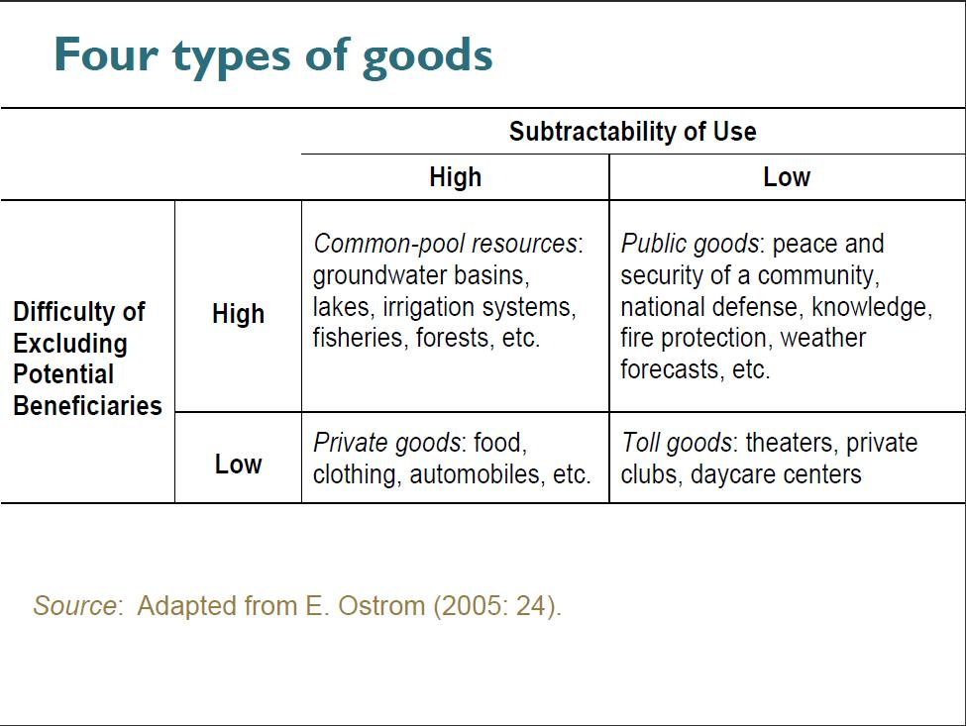

Slide 32
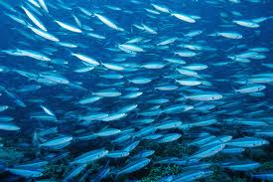

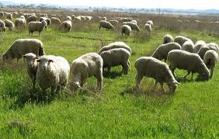
How do humans interact with ecosystems to maintain long-term sustainable resource yields?
Multiplicity of governance and ownership arrangements
Elinor Ostrom: Governance of the Commons
How societies develop diverse institutional arrangements for managing natural resources and avoiding ecosystem collapse and prevent resource exhaustion?

Slide 33

Elinor Ostrom: Governance of the Commons (contd.)
Multifaceted nature of human–ecosystem interaction
Diverse social-ecological system problems
No singular or unique "panacea" for these problems

Slide 34
“Design Principles" for stable common pool resource management
Improve efficiency, prevent resource exhaustion, and avoid ecosystem collapse
Define boundaries clearly (to exclude external un-entitled parties)
Adapt rules regarding appropriation & provision of common resources to local conditions
Collective-choice arrangements: allow resource appropriators to participate in decision-making process
Effective monitoring (by monitors part of or accountable to appropriators)
Graduated sanctions for resource appropriators who violate community rules
Mechanisms of conflict resolution that are cheap and easy of access
Self-determination of community recognized by higher-level authorities
For larger common-pool resources: organize through multiple layers of nested enterprises - small local CPRs at base level

